Slide 1

How To Read An Agronomic Soil Report

Slide 2
Why a soil test?
Removing the guessing
Another tool in your tool box
Faster results when you have a baseline
Based in Science
Less inputs save $ and time
Reduce amendment use

Slide 3
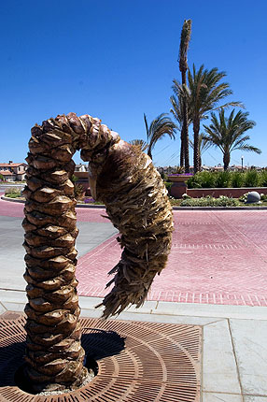
Why a soil test?
Skeletal Soil
  -Nature salt blooms
  -Micronutrient hotspots
Insurance policy
-$$$ projects
-Reputation

Slide 4

Why a soil test?
Photos by owtdoor.com

Slide 5
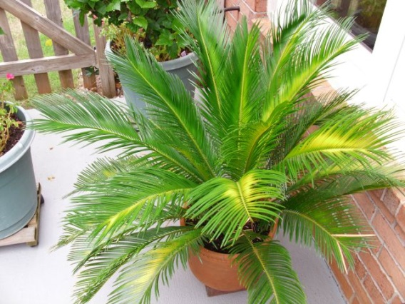
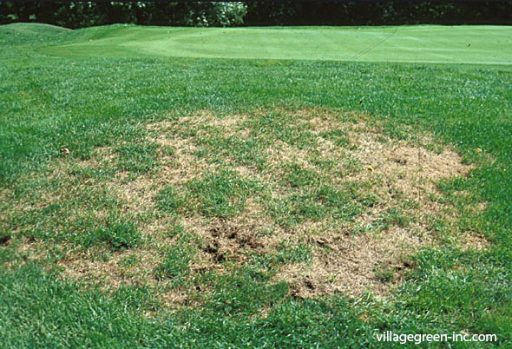
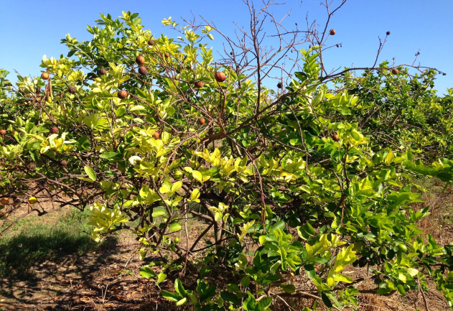
Why a soil test?
Preventative maintenance
What happens when plants feel yucky?

Slide 6
How to take a sample
Understanding your testing goals
  Ask yourself: what do I want to test?
    Community garden?
    All the landscaping?
    A single tree?
Create a sample plan.

Slide 7
Caution: Be aware of past amendment applications.
Combining Different soils will lessen value of test

Slide 8
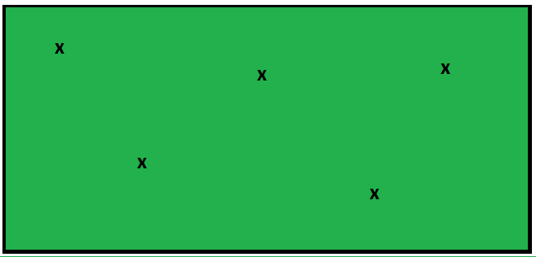

Garden & Lawn:
Sampling Example
x
x
x
X
X

Slide 9

Tree: Sampling example
For new trees: Highly recommend sampling native soil. NOT the potting soil that came from nursery

Slide 10
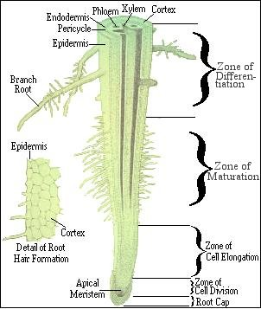
Tree: Sampling example

Slide 11
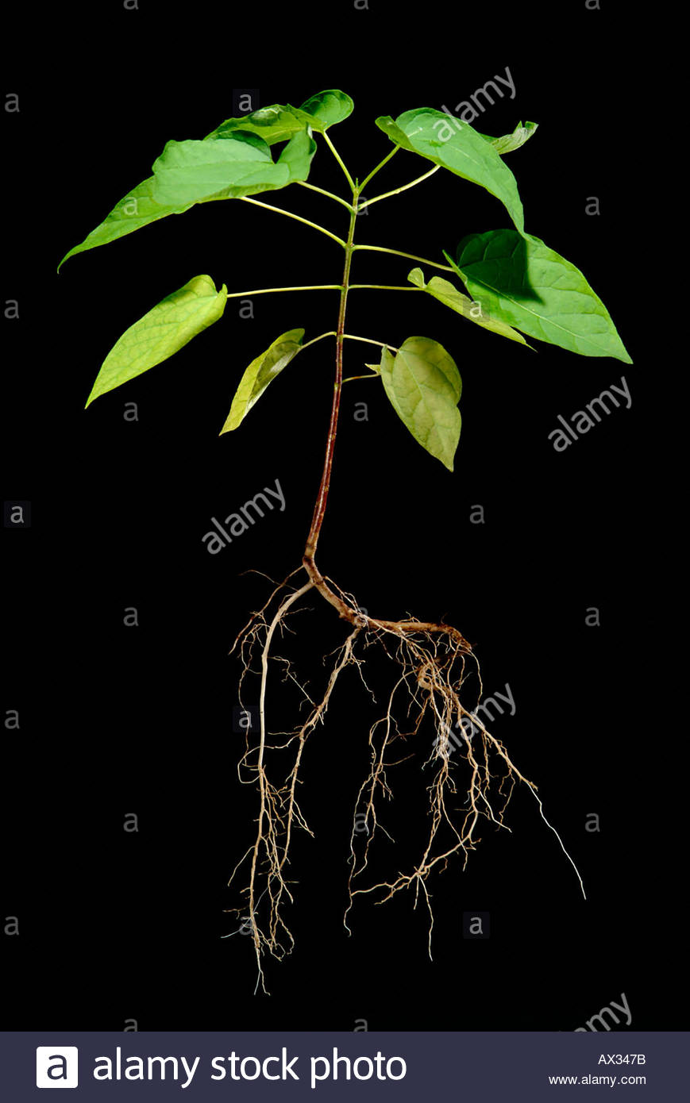
Tree: Sampling example

Slide 12
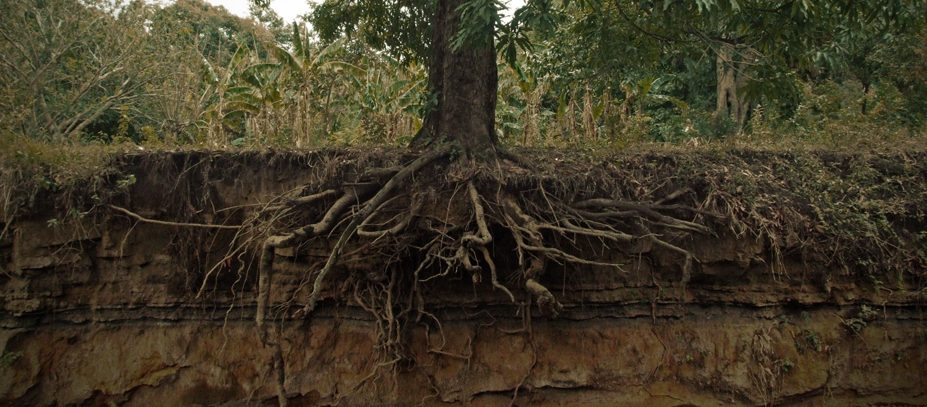
Tree: Sampling example

Slide 13
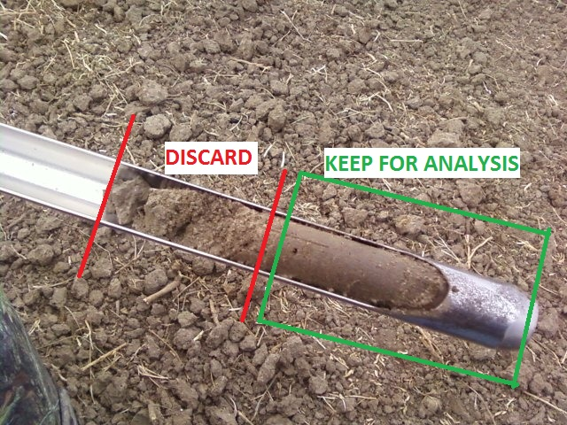
Garden: Sampling example
Use a soil probe
Sample 5-6 random locations
6 inches deep
Discard top 2 inches
Place all sampled in one bag

Slide 14
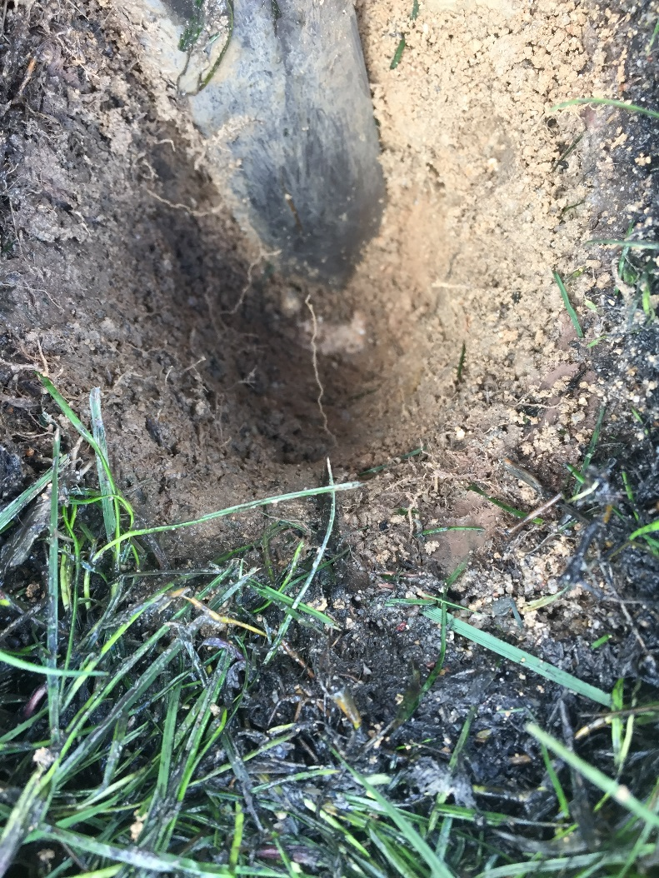
Garden: Sampling example
No soil probe
Dig 5-6 random holes that are 6 inches deep
Collect a ½ cup of soil from the bottom of each hole
Place all samples in one bag

Slide 15
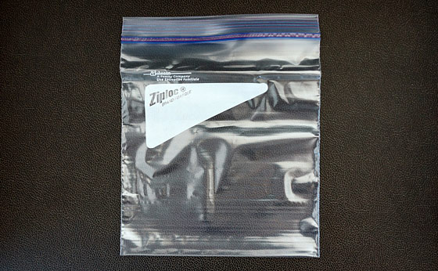
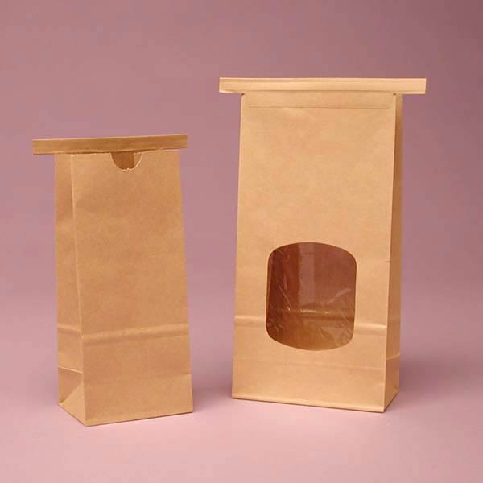

Appropriate Soil Sampling Bags

Slide 16

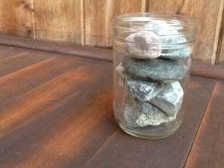
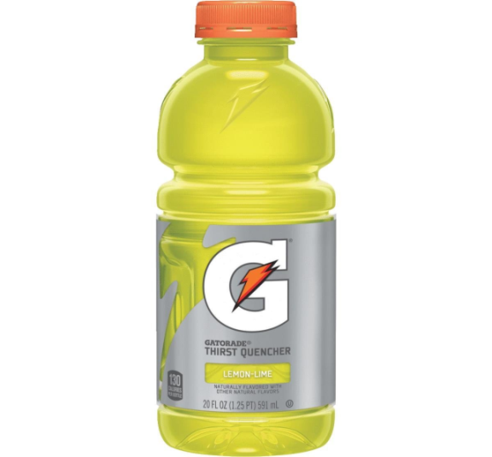
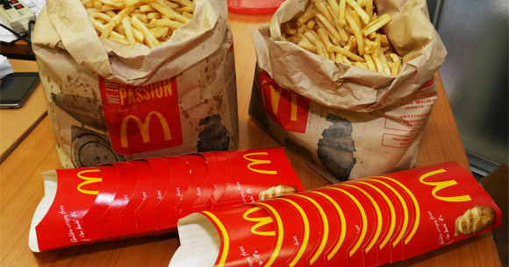
NOT Appropriate Soil Sampling

Slide 17
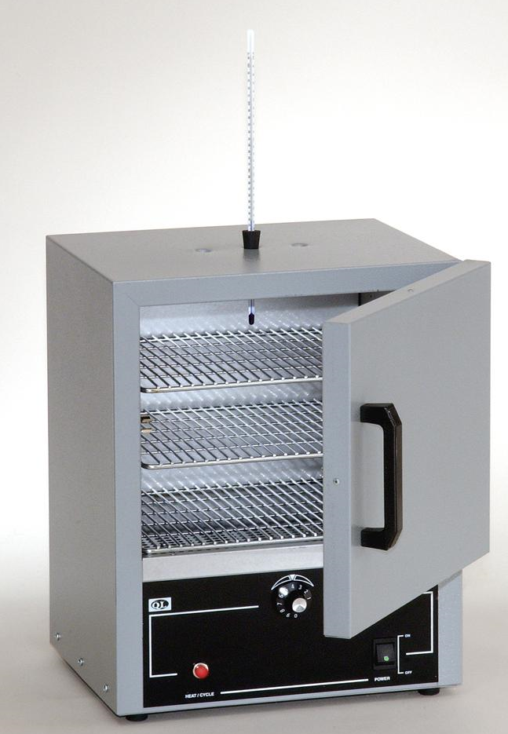


The process:
Dry the Sample
Grind up clumped soil and Sieve out the rocks
Dry in the oven over night

Slide 18
Why Are We All Here Today?
How to read a laboratory soil report
Be able to explain the report to others
Ensure soils meet site specification

Slide 19
What is Top Soil ?
Definition: ‘Upper, outmost layer of soil, usually the top 2 inches to 8 inches depth (wikipedia)
Nutrient Rich
Organic Matter
Microorganism

Slide 20
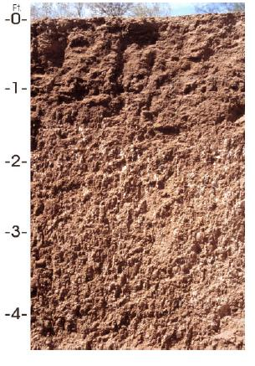
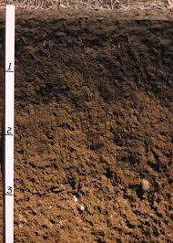
Mid-West Arizona

Slide 21
The Soil Report: What does it all mean?
Nutrient Deficiencies
  Over farming & not replenishing nutrients
  Nutrient tie up in the soil
Nutrient toxicities
  Salty irrigation water
  Over application (fertilizer, manure, compost)
Nutrients out of balances
Over watering
Low oxygen in soil, lead to root/seed rot

Slide 22
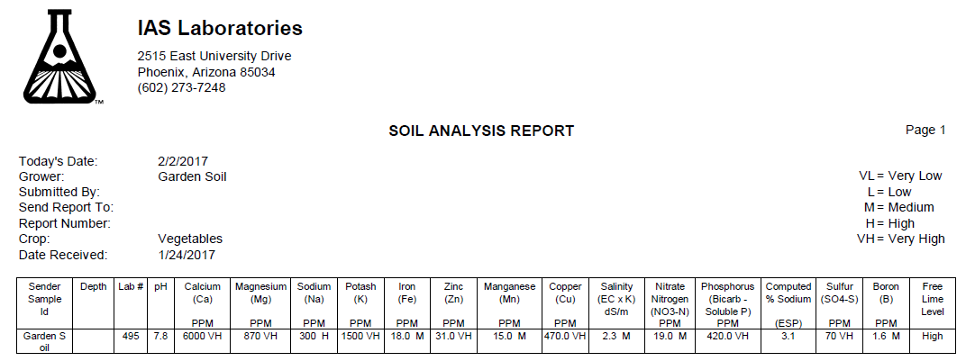
The Soil Report:
What does it all mean?

Slide 23
The Soil Report: pH
*High pH will reduce nutrient availability for root up take
*Low pH can:
-Increase nutrient availability
-Cause micronutrient toxicities

Slide 24
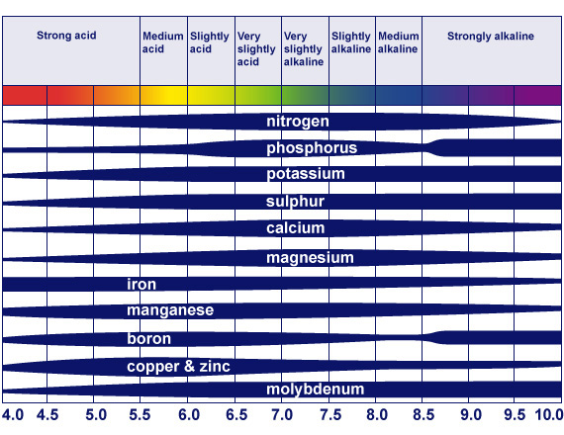

Slide 25
The Soil Report: Salts – Good and Bad
Salts are cations
  Adequate concentration
  Balanced

Slide 26
The Soil Report: Calcium
Low Calcium Can:
  Reduce gas exchange between soil and atmosphere
  Reduce water infiltration
  Deflocculation of soil particles
  Soil crusting

Slide 27

The Soil Report: Low Oxygen
Signs of Low Oxygen:
  Reduced calcium
  Low salinity
  Low/No free lime
  Narrow Ca:Mg – Stunted plants

Slide 28
The Soil Report: Calcium, Magnesium & Boron
Wide Ca:Mg
  Reduce soil moisture retention
  Stunting of plants
Boron aids in calcium and magnesium up take

Slide 29
The Soil Report: Sodium
High sodium:
  Increases osmotic pressure required for water uptake
  Increase leakage of solutes (yellowing)
  Reduces germination and increases stunting of plants

Slide 30
The Soil Report: Potassium
High Potassium:
  Blocks the uptake of calcium and magnesium
  Leaf margin burn
Low Potassium:
  Lodging (plants fall over)

Slide 31
The Soil Report: ESP
High Estimated Sodium Percentage
  Unbalance salts
  Sodium build up in the soil
  Slow infiltration of the irrigation water

Slide 32
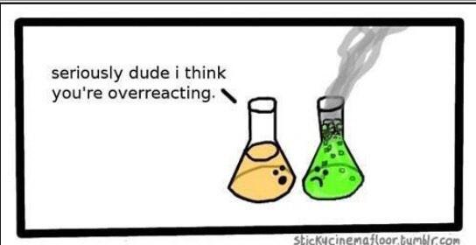

Slide 33
The Soil Report: Salinity (not sodium)
High salinity will reduce yield/plant growth
    General landscape <3 dS/m
    Salt tolerant plants <4-5 dS/m

Slide 34
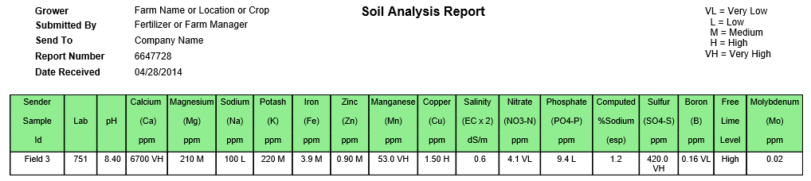
The Soil Report: Too much water
Signs of over watering
    Low sodium
    Low salinity
    Low nitrate
Severe signs of over watering
    High sulfur
    High manganese
    Algae growth

Slide 35
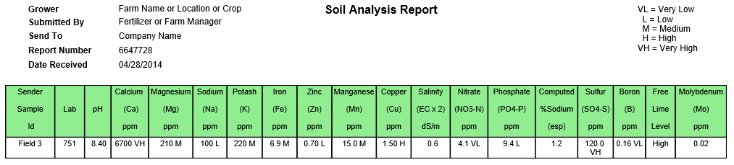
The Soil Report: Micronutrients
Balanced micronutrients from highest to lowest concentration
  Iron > Manganese > Zinc > Copper
  Too much Mn, Zn, Cu is toxic
  Fe:Cu balanced

Slide 36
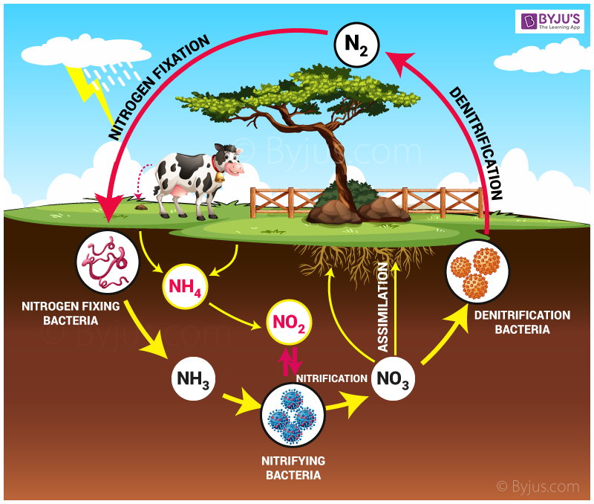
Nitrogen Cycle
Too Much
  Plant burn
Too little
  Reduced plant growth
Ideally:
  Spoon feed to reduce waste
Leaching

Slide 37
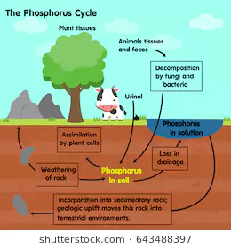
Phosphorus Cycle
Too Much
  Block iron uptake
Too little
  Excess root growth
  Canopy thinning
  Death
Required
  DNA formation
  Energy cycle
Leaching

Slide 38
The Soil Report: Sulfur
Elemental S ≠ Sulfate-S
  Enzyme formation
  Lower soil pH

Slide 39
The Soil Report: Recommendation
Lbs/1000 sqft

Slide 40
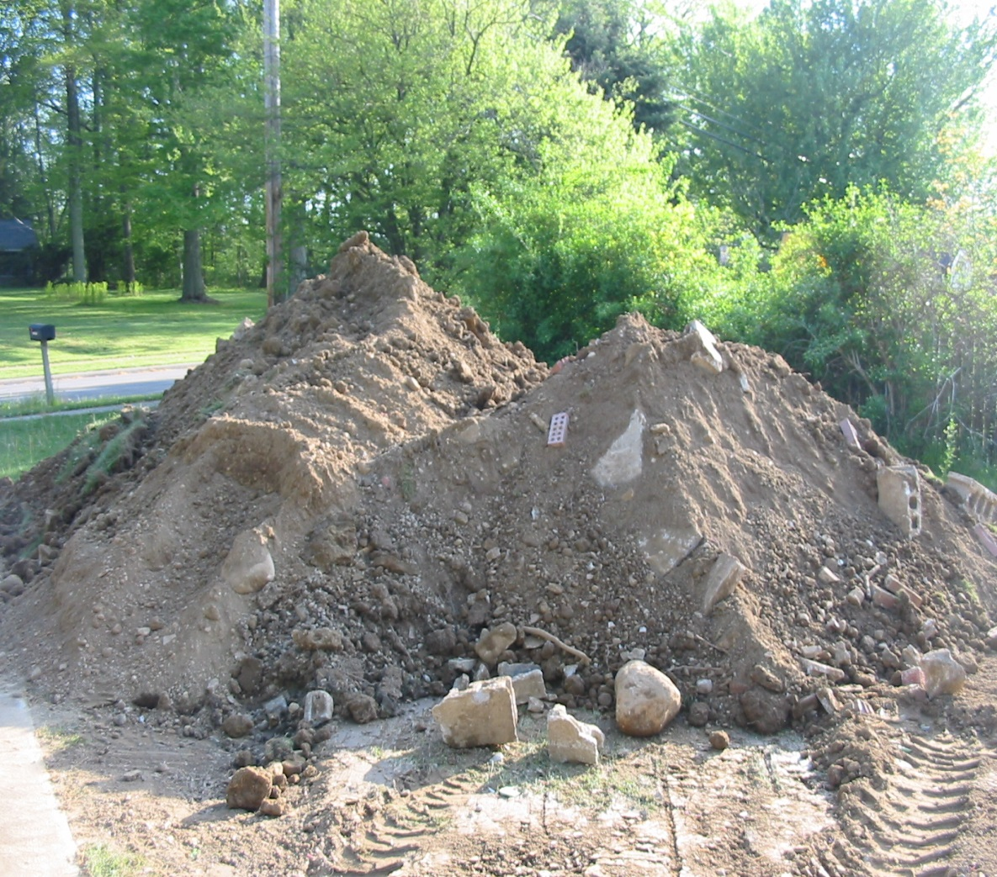
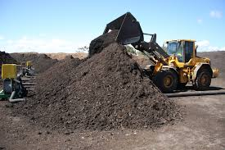
Your Project: Putting This All Together

Slide 41
Your Project: Soil Before

Slide 42
Your Project: Compost

Slide 43

Your Project: Soil After

Slide 44
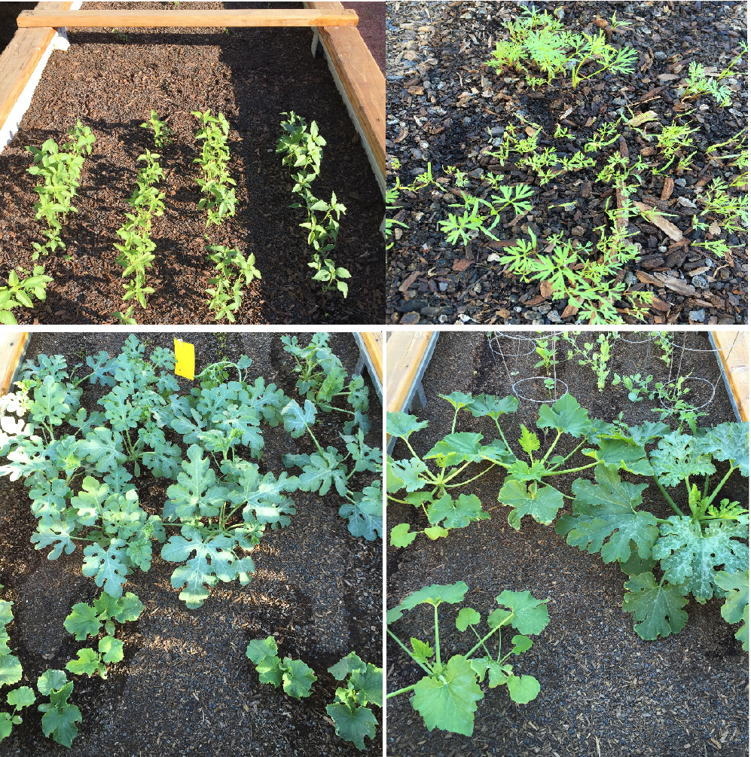

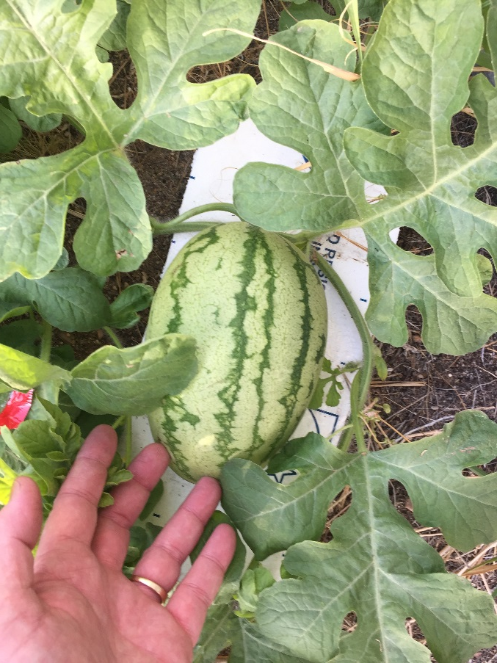
The lab’s Garden
First Planting September 2016

